Slide 1
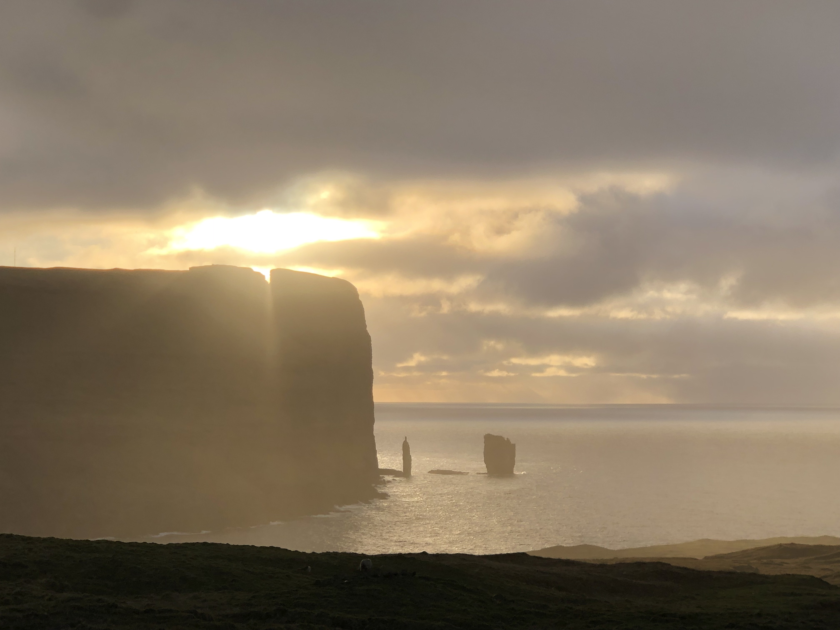
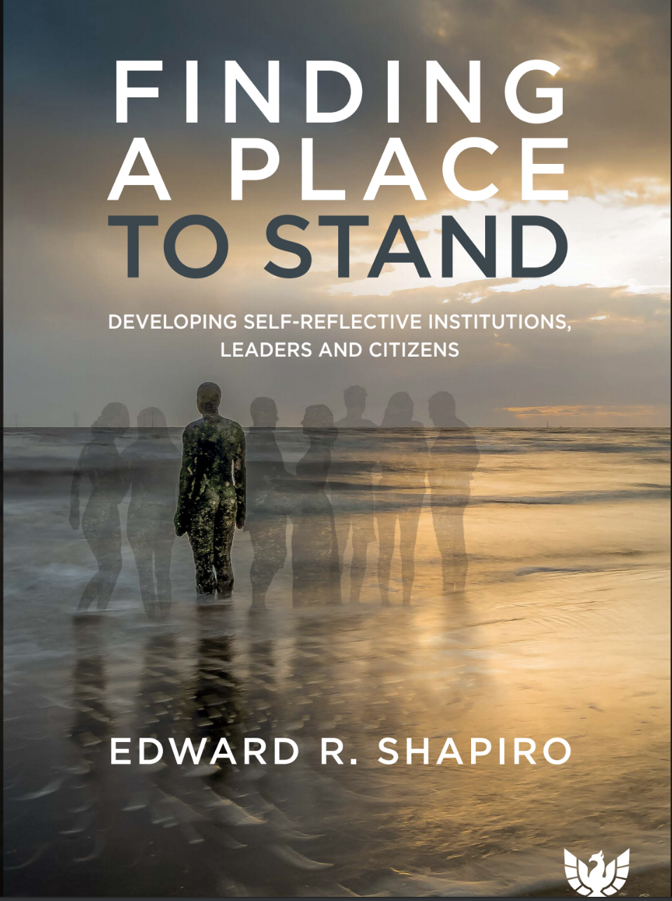
Former Medical Director/CEO, Austen Riggs Center
Clinical Professor, Yale Child Study Center

Slide 2
Four issues
How do we learn to be a member
Relationship and Relatedness
Making sense of experience in role
Institutional Mission as a lens into society

Slide 3

What are we up to in putting on conferences?
Eric Miller (in Group Relations Reader 1, 1976): “(In group relations conferences) I am engaged in covert political activity which I would prefer to deny. My latent goal is to induce members to become agents of scrutiny and change in their external organizations.”
Basic question: Why do we do conferences?
Answer: We have a method that might help to improve our world. But, how?
“Members are free to learn in whatever way they decide”

Slide 4
What conversations are happening in society that our work speaks to?
As individuals, we are isolated, targeted, disengaged and feeling powerless to impact the world around us. We need each other to be effective, but how?
Many of our institutions, our access points to the larger society, are in danger of losing touch with their missions. Without reliable institutions that stand for something, autocrats are taking over.
________________
So, how (and where) can we join with others as citizens to improve the world around us?

Slide 5
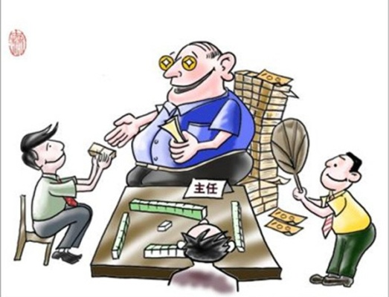
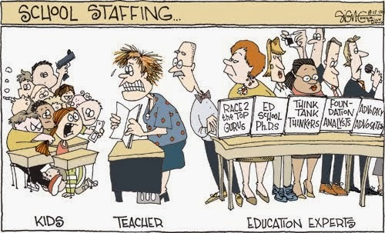
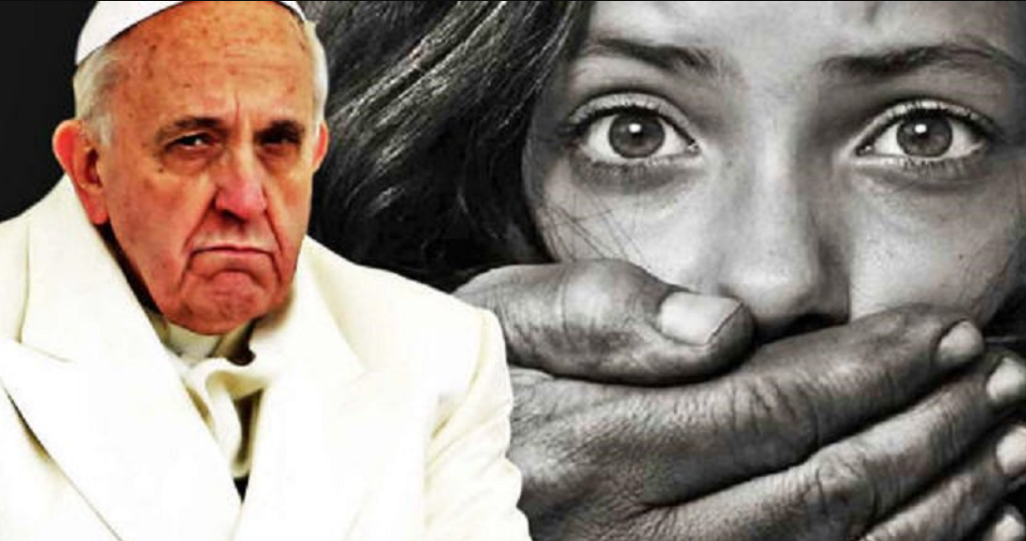
Institutions losing touch with mission:
Government (special interests):
Religion (sexuality
and faith):
Education
(cost and technology):

Slide 6
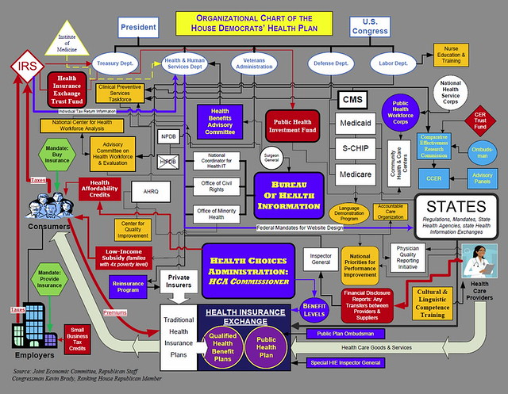

Institutions losing touch with mission:
Can we as members do anything about it?
Health Care (bureaucracy):
Commercial (brands as identity):

Slide 7

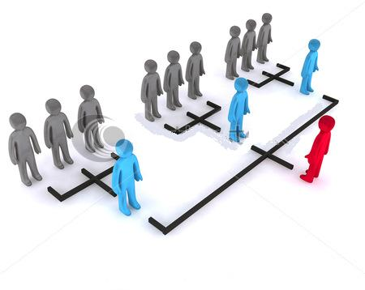
How to mobilize and strengthen citizen role?
Collective
  Social media
  Community organizing
  Heroes (Parkland students)
Strengthen Institutions
  Mission and roles
Pressure politics; increased voting
Sharpen mission links to society’s needs; enhance staff authority to see the outside society as citizens

Slide 8
What do we learn in Group Relations Conferences?
We learn what it takes to become a member: a shift in identity from “me as an individual” to “me as a member” (joining something larger than oneself) and from seeing you as “other” to seeing you as “one of us”)
Primary Task, Role, Authority and Boundaries
Making sense of institutional irrationality in relation to leadership and authority

Slide 9
How do we become a member?
Joining: Listening for, “How are they right”?
What do we join?
We join “the task” (the mission). A “transcendent reference”
Leadership
leadership belongs to the one who can most clearly define the task

Slide 10

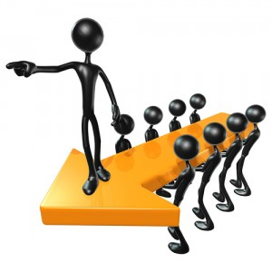
Leader Power vs Leader Authority
A leader has power if…
A leader has authority if…
they represent a mission that others are willing to use their own authority to join
they command resources so as to be able to compel others to work

Slide 11
Organizations vs. Institutions
An organization is visible: the day-to-day workings of the system, the policies, concrete procedures and structures of the organization’s work
An institution is a structure in the mind that includes the larger context and the way the institution’s mission carries out work on behalf of the larger society. Institutions shape and project an image of themselves by articulating their mission. They are open systems, with a task boundary to the outside world, which is an access point for its members to develop a citizenship perspective

Slide 12
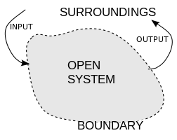
Open Systems
“Individuals, small groups, and institutions are all open systems, linked by the communication of affects” (Modell).
They all share these characteristics: an internal world, an external world, and a boundary function that links the two.
For institutions, the mission is the boundary.
For the staff, the intensity and significance of the mission depends on linked values and ideals.
(Affective communication)

Slide 13
Mission: a boundary to the outside world
It is negotiated between the institution and the outside world and links the institution’s survival to the needs of the larger society.
It authorizes and energizes the work of participants in the institution’s internal world.
It is a marker of the institution’s efforts to grapple with reality.
It is a container for staff feelings and commitments (ideals and values) and for their affective engagement with the world
It is a stabilizing force in the face of organizational regression, and
If the links to society are clear, it is a citizenship lens onto the outside world.

Slide 14

Mission example: values and ideals
Apple mission now: Apple designs Macs, the best personal computers in the world, along with OS X, iLife, iWork and professional software. Apple leads the digital music revolution with its iPods and iTunes online
Apple according to Steve Jobs: To make a contribution to the world by making tools for the mind that advance humankind
[Values: narcissism (“the best in the world”)
  Staff are technicians
[ Values: human development
Staff can be full persons with a view onto the world as citizens

Slide 15
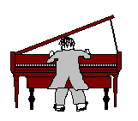
Joining: How are they right?
The piano story

Slide 16
The interpretive stance
People in roles (each, a function of the task)
Interpret experience in roles/negotiate with others
Relationship and relatedness

Slide 17
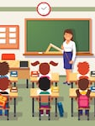
The interpretive stance
Role: a function of the organization’s task
Different people take up roles in different ways
Role brings the person and the context (the institution) together
Making sense of experience in role
Story: the young psychologist

Slide 18
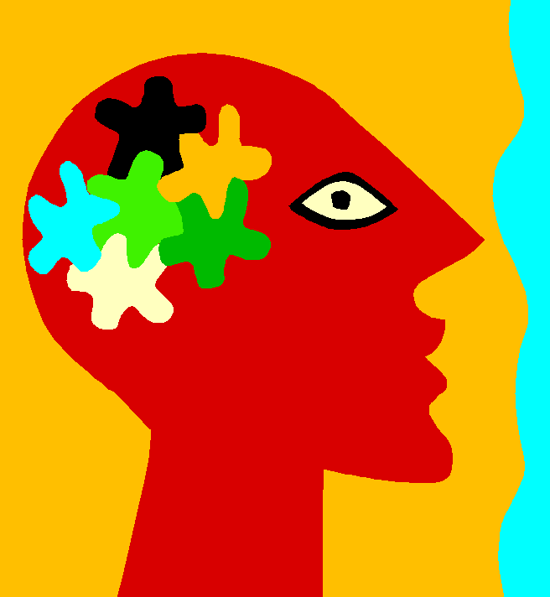

Managing the Pressures of Society/Culture
Personal boundary:
Political boundary: The group in the mind

Slide 19
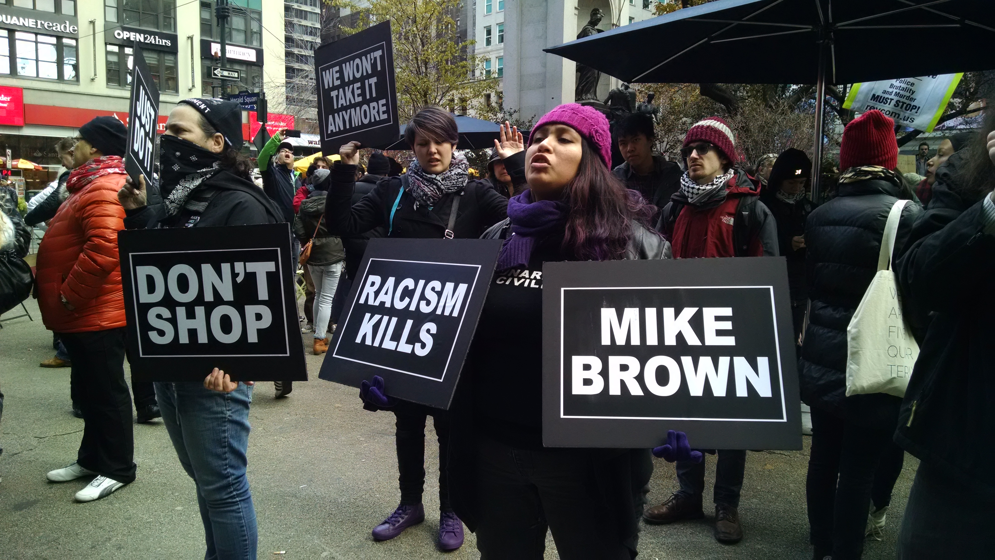
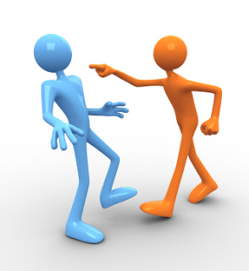
Citizen stories: Frank (America)
Frank: A 35 year old unaffiliated voter, African-American. “If a black man represents the restaurant,” he says, “the customers get scared. Talent is not seen. You are black first.” “No one is in charge,” he says. “It is just happening. You are seen as black first. White males are hung up on power. If they can’t control you, they diminish you.”
In the racially polarized American culture, Frank cannot easily experience himself as an individual American struggling with diverse opportunities and complex constraints. He must first locate his experience within the context of other African Americans who, he believes, passionately and deeply share his picture of the ethnically oriented social world around them. In response to the culture, his initial social group is formed through an ethnic identification.

Slide 20

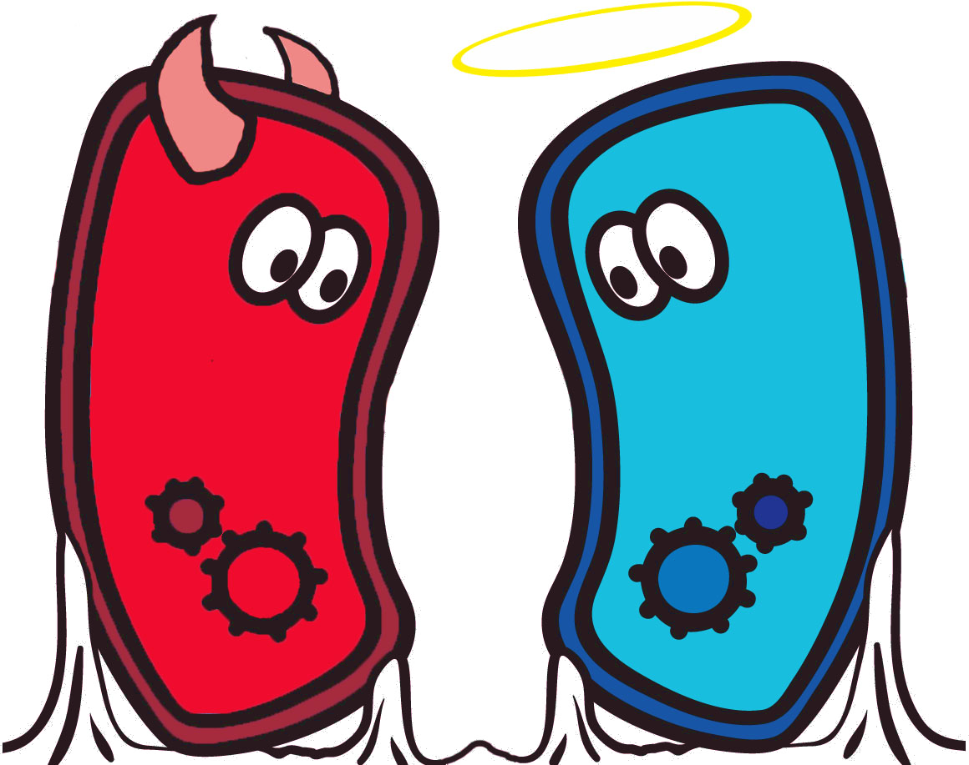
Frank (America)
American Culture: History of slavery
[America’s mission: integration of differences]
Polarization: social projection
(we are on a large scale grappling with how we categorize people as “other”, e.g., Obama, Trump)
Adaptation: First, joining a group in the mind
Mobilizing political voice on behalf of a group
(social justice: developing institutions?)

Slide 21
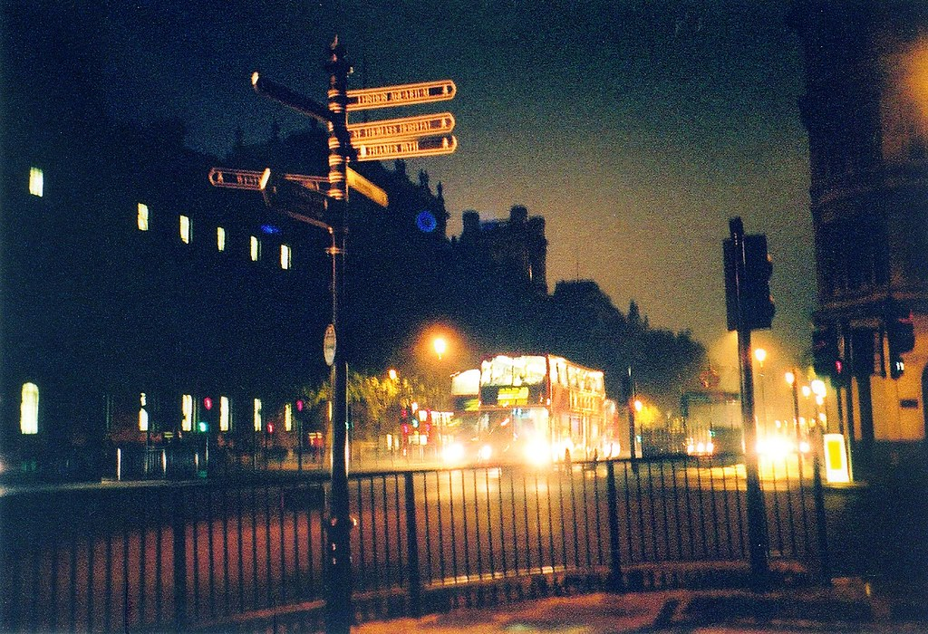
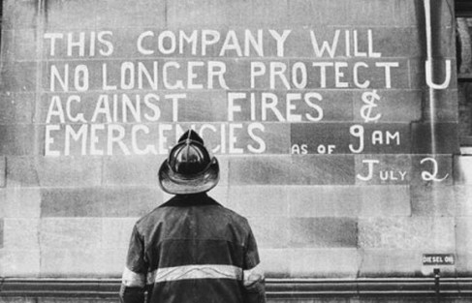
Citizen Stories: Tom (UK)
Tom: a UK citizen from West Indian background. He is on a bus during the fireman’s strike. Black teenagers are hassling the white bus driver. The white passengers don’t move.
Tom says to himself: Why do I have to do this? I don’t like the role I am in.

Slide 22


Tom (UK)
British Culture: Colonialization, Commonwealth, Diversity
Identities (multiple group memberships): Black man, social worker, Church of England, father
Integrity: obligation to the most mature meaning available to us (Erikson).
Internal negotiation between internalized groups toward citizen role

Slide 23
Integrating memberships into citizen role
Empathizes with black anger (sees how they are right)
Mission focus: on society stresses
Mission: interdependency and transcendence; recognizes threat of strike, and vulnerability of society
Understands need for paternal presence
“I am at stake here”
(“Only I can do this.”)
Irritated at youths casting bad image of blacks, yet tempted to side with them
Black man
Social worker
Church of England
Father
Why me?
I don’t like this role

Slide 24


Humanity is a multicellular learning system in the process of development
Interpretation of society can be negotiated within and across institutions
It learns through forming bounded entities, each with a learning task on behalf of the whole
Each of us (as a cell) brings our multigenerational histories and family roles into membership. Mission is a lens to society

Slide 25
Four issues: group relations going forward
Learning to be a member
Relationship and Relatedness
Making sense of experience in role
Institutional Mission as a lens into society
APPLYING OUR WORK!

